Slide 1
Exploring Multi-objective Optimization for Designing Multi-view Clustering Techniques

Slide 2
What is Multi-view Learning?
Multi-view learning is a technique in which one function is used to model a particular view of the input data.
Functions are jointly optimized to exploit the different views of the same input data.
Views are obtained from multiple sources or different feature subsets.

Slide 3
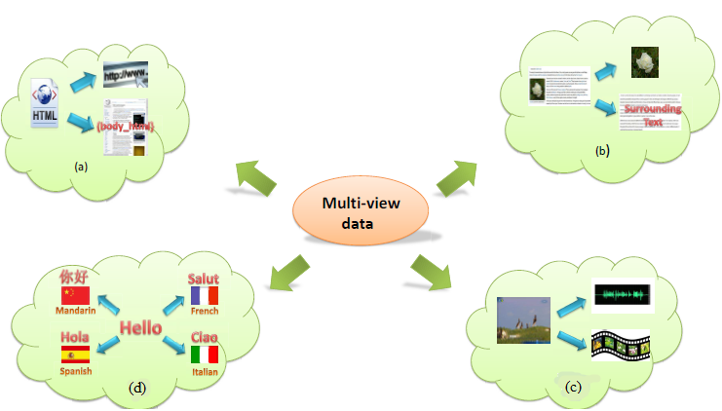
Example of Multi-view Data
Multi-view data: a) a web document can be represented by its url and words on
the page, b) a web image can be depicted by its surrounding text separate to the
visual information, c) video clips are combinations of audio signals and visual
frames, d) multilingual documents have one view in each language.

Slide 4
Disadvantages of single-view Learning
Conventional machine learning algorithms, concatenate all multiple views into one single view to adapt to the learning setting.
Each view has a specific statistical property.
Concatenation causes overfitting in the case of a small size training sample.

Slide 5
Principles for Multi-view Learning
There are two significant principles
Consensus Principle
Complementary Principle

Slide 6
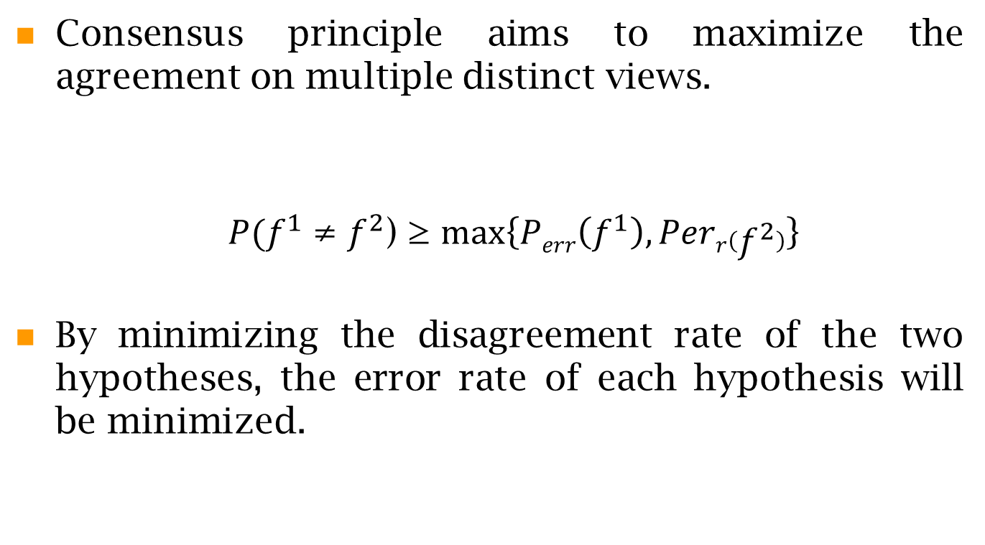
Consensus Principle

Slide 7
Complementary Principle
The complementary principle
in a multi-view setting, each view of the data may contain some knowledge that other views do not have
therefore, multiple views can be employed to comprehensively and accurately describe the data.

Slide 8
View Generation
The priority for multi-view learning is the acquisition of redundant views in a multi-view setting, each view of the data may contain some knowledge that other views do not have
Multiple view generation not only aims to obtain the views of different attributes, but also involves the problem of ensuring that the views sufficiently represent the data and satisfy the assumptions required for learning.
View Construction
View Evaluation

Slide 9
View Construction
In many cases, however, no natural multiple views are available because of certain limitations.
The preliminary work of multi-view learning concerns the construction of multiple views from this single view in a multi-view setting, each view of the data may contain some knowledge that other views do not have.
Generating different views corresponds to feature set partitioning, which generalizes the task of feature selection.
Feature set partitioning decomposes the original set of features into multiple disjoint subsets to construct each view.
The random subspace method (RSM), as an example of a random sampling algorithm, incorporates the benefits of bootstrapping and aggregation.
This method relies on an autonomous, pseudo random procedure to select a small number of dimensions from a given feature space.

Slide 10
View Evaluation
Another significant aspect is to evaluate these views and ensure their effectiveness for multi-view learning algorithms.
Several approaches have been proposed in the multi-view learning literature that analyze the relationships between multiple views or cope with the problems resulting from the violation of view assumptions or the noise in the views.
Muslea et al. (2002b) first introduced a view validation algorithm which predicts whether or not the views are sufficiently compatible for solving multi-view learning tasks.
This algorithm tries to learn a decision tree in a supervised way to discriminate between learning tasks according to whether or not the views are sufficiently compatible for multi-view learning.
The label of each instance is generated automatically by comparing the accuracy of single- and multi-view algorithms on a test set.

Slide 11
View Combination
One traditional way to combine multiple views is to concatenate all multiple views into a single view to adapt to the single-view learning setting.
This concatenation causes over-fitting on a small training sample and is not physically meaningful because each view has a specific statistical property.
Co-training style algorithms usually train separate but correlated learners on each view, and the outputs of learners are forced to be similar on the same validation points.
Under the consensus principle, the goal of each iteration is to maximize the consistency of two learners on the validation set. Certainly there may be some disagreement between the predictions from the two learners on the validation set; however, this disagreement is propagated back to the training set to help to train more accurate learners, thus minimizing the disagreement on the validation set in the next iteration.

Slide 12
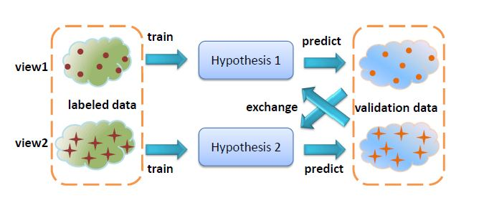

Slide 13
Existing Techniques
Multi-view k-means
Multi-view EM
Multi-view Spherical K-means
Clustering Ensembles : generate different partitioning using different views and finally combine using some ensemble technique

Slide 14
Multi-view k-means clustering
In each iteration, k-means is applied in one view.
Interchange the partition information to another view and run k-means in the second view again.
After termination, consensus mean is computed for each cluster and view.
Each example is assigned to one distinct cluster that is determined through the closed concept vector.

Slide 15
Applications
Multi-view clustering is applied in web document classification problem.
Given a small set of labeled training data and a large set of unlabeled data, co-training can reduce the difference in error between co-trained classifiers and fully supervised classifiers trained on a labeled version of all available data by 36%.

Slide 16
Multi View AMOSA
Apply spherical k-means on each view separately.
State representation and
Archive initialization
Divide the dataset based on the basis of views.
Compute three objective function on each view.
Input normalized data(10% labeled data+ unlabeled data)
Apply mutation operator
Clusters obtained from each view are combined using multi-view ensemble technique, i.e, the pair of clusters whose number of overlapped data items is the largest, are matched in the way that they are denoted by the same label. The process is repeated.
The centroid chromosome is updated.
Choose a single optimum solution.
STOP
Form pareto optimal front

Slide 17
K₁¹ : Cluster 1 of view 1
K₃² : Cluster 3 of view 2
K₁¹
K₃²
Applying multi-view ensemble.
K₂: New cluster labeled 2 formed by ensemble technique
K₂

Slide 18
Reference
Xu, Chang, Dacheng Tao, and Chao Xu. "A survey on multi-view learning."arXiv preprint arXiv:1304.5634 (2013).
Steffen Bickel and Tobias Scheffer. 2004. Multi-View Clustering. In Proceedings of the Fourth IEEE International Conference on Data Mining (ICDM '04). IEEE Computer Society, Washington, DC, USA, 19-26.
Xijiong Xie, Shiliang Sun:Multi-view clustering ensembles. ICMLC 2013: 51-56

